Slide 1
Environmental Health
&
Toxicology

Slide 2


Environmental Health?
Air
Sunlight
Food
Noise
Water
Soil
The study of how the environment
affects your health.

Slide 3
Environmental Health
Environmental health addresses all the physical, chemical, and biological factors external to a person, and all the related factors impacting behaviours.
It encompasses the assessment and control of those environmental factors that can potentially affect health. It is targeted towards preventing disease and creating health-supportive environments.

Slide 4
What is Environmental Hazards & Risks?
Environmental hazards are incidents we face from the environment that harm our physical, mental, moral, ethical and spiritual wellbeing;
Hazard is explained by the level of risks;
Risk is the possibility of suffering harm from an event (Hazard) that can cause injury, disease, economic loss or environmental damage.
E.g.; if we say the life time cancer risk from exposure of a chemical is 0.001; this means 1 in 1000 people could have Cancer from the exposure of that chemical in a life span time (60-70 years);
Risk assessment is the procedure through which probability of harm to human health, to society or to environment are determined that may result from exposure to specific hazard.

Slide 5
What are the major types of Hazards?
The categorization of hazards are mainly depends on how it harms human being. The categorization are:
Cultural hazards: example – drug addiction, unsafe working, smoking, poor diet, drinking driving, poverty;
Chemical Hazards: Air pollution, Water Pollution, food poisoning, soil pollution;
Physical Hazards: Noise, Fire, storms, earthquakes, volcanic eruption, floods;
Biological hazards: Pathogen, pollen, Bird flue;
Nuclear Hazards: Radiation leakage, excessive exposure, UV radiation.

Slide 6
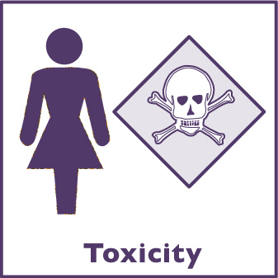
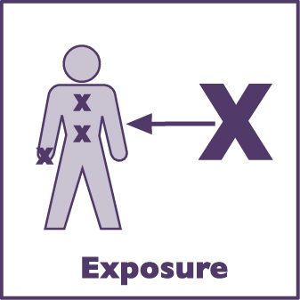
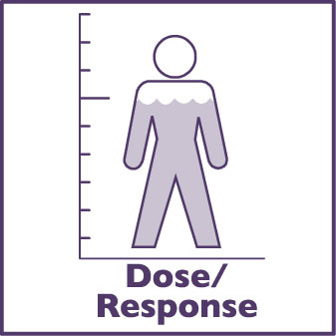
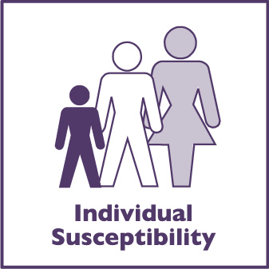



The 7 Core Concepts
To understand the field of environmental health,
you need to understand seven core concepts

Slide 7
Toxic means poisonous or dangerous;
Toxicology is the study of poisons;
Toxicity is a measure of how dangerous a chemical is.

Slide 8
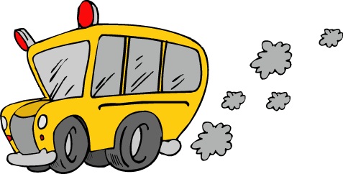

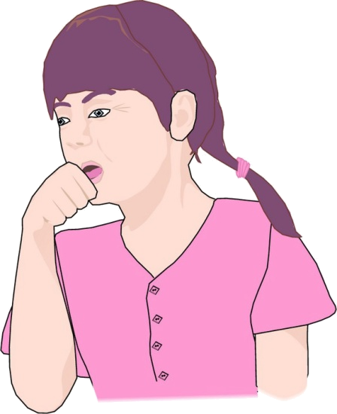
Exposure is
The total amount of a hazard that comes in direct contact with your body.

Slide 9



The 3 parts of exposure
The
Source
of the hazard
(bus exhaust)
The
Contact
(inhaled fumes)
The
Environmental
Pathway
(air)

Slide 10
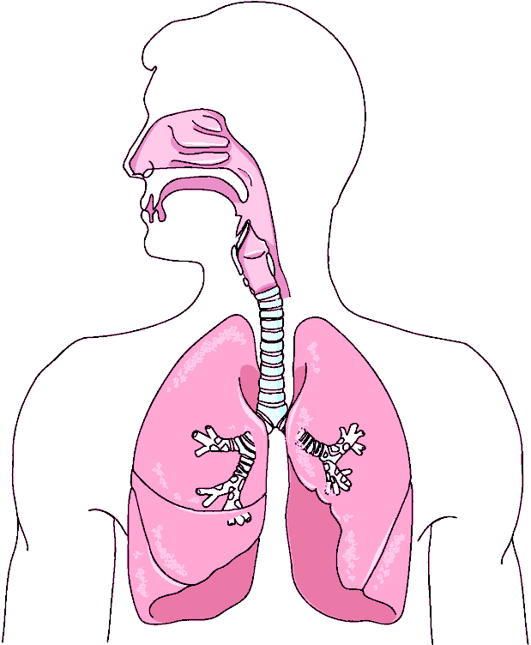
Route #1: Inhalation
Hazard!
Inhalation:
Breathing. When chemicals enter the body through this route of exposure, they can get stuck in the lungs and/or be taken up into the bloodstream.

Slide 11
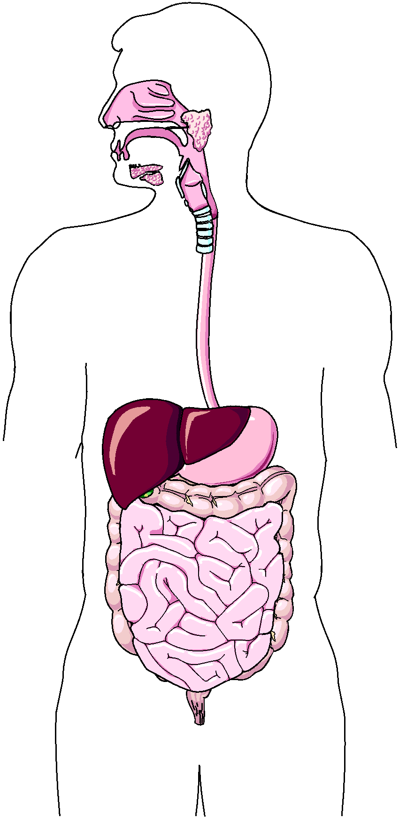
Route #2: Ingestion
Hazard!
Ingestion:
Swallowing (usually by eating or drinking). When chemicals enter the body through this route of exposure, they can easily be taken up into the bloodstream.

Slide 12
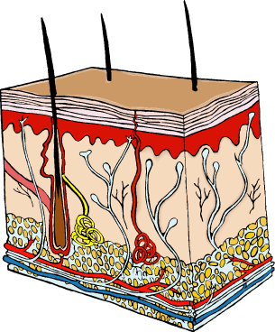

Route #3: Dermal Absorption
Hazard!
Dermal Absorption:
Absorbing a chemical through any part of the skin, including the eyes. When chemicals come in contact with the skin, they can sometimes enter the bloodstream through this route of exposure.

Slide 13
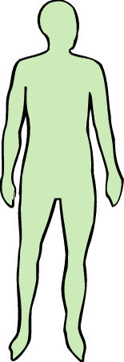
What is dose?
X
X
X
X
Exposure
Exposure
Exposure
Exposure
X
X
X
X
X
X
X
X
X
X
X
X
Dose
Dose
Dose
Dose
X
X
X
X
X
X
X
X
X
X
X
X
X
X
X
X
X
X
X
X
X
X
X
X
X
X
X
X
X
X
X
X
X
X
X
X
X = hazard
X = hazard
X = hazard
X = hazard
Dose is the amount of a hazard that actually enters your body.
Dose is the amount of a hazard that actually enters your body.
Dose is the amount of a hazard that actually enters your body.
Dose is the amount of a hazard that actually enters your body.

Slide 14


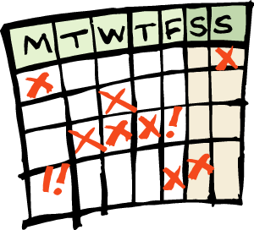
Dose can depend on…
Dose can depend on…
Duration of Exposure:
How long?
Duration of Exposure:
How long?
Frequency of Exposure:
How often?
Frequency of Exposure:
How often?
Body Size:
How big or small are you?
Body Size:
How big or small are you?
L
L
M
M
S
S
S
S
The larger the dose, the more extreme
the response will be.

Slide 15
Dose-Response Relationship:
As the dose of a toxicant increases,
so does the response.
4
RESPONSE
0-1 NOAEL
2-3 Linear Range
4 Maximum Response
3
2
0
1
DOSE
DOSE DETERMINES THE BIOLOGICAL RESPONSE

Slide 16
Some people are more likely than others to get sick when they are exposed to environmental hazards. This might be because of their genetics, body size, age, gender or general health. This is called their individual susceptibility.

Slide 17
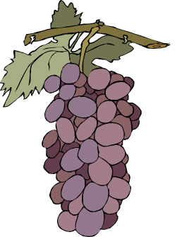

Risks & Benefits
What are the risks and benefits when grape growers use pesticides on their crops?

Slide 18
Risks & Benefits
BENEFITS
RISKS
No bugs!
Better looking fruit that is more visually appealing
Bigger crops so farmers can make more profit
People ingest pesticides with the fruit and get sick
Pesticides get into dirt and water
Animals ingest pesticides and get sick
By understanding the risks and benefits that we face each day, we can make decisions that reduce our risk and keep us as safe and healthy as possible.

Slide 19
What is environmental justice?
Environmental Justice (EJ) means that everyone has a right to live in an environment that doesn’t make them sick, regardless of their race, culture, or income.

Slide 20
Well informed and well communicated communities can take necessary action to minimize environmental hazards in a sustainable way.

Slide 21
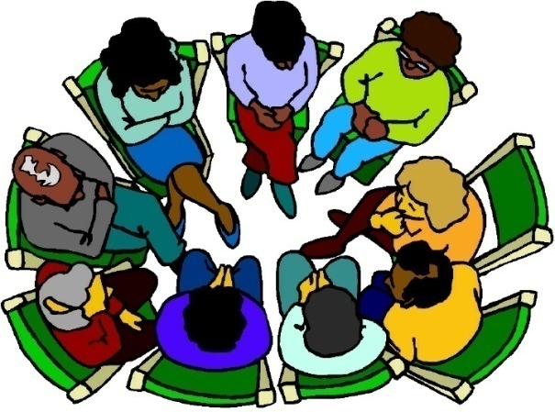

The EJ Process
Who is producing the hazard?
Establish a dialog between the decision makers, scientists, and the affected community.
Empower community members to bring about change.
Who is being exposed?
Share information and decisions with community members.
Who are the decision makers?

Slide 22
What is a Poison?
All substances are poisons;
There is none that is not a poison.
The right dose differentiates a poison and a remedy.

Slide 23
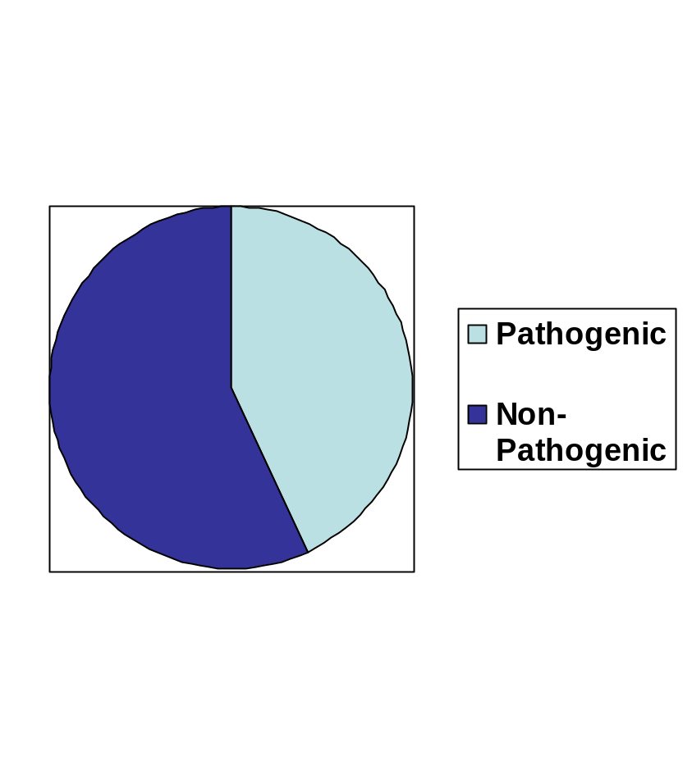
Pathogenic vs. Non-pathogenic
Environmental Health
43% of all disease-related deaths are from pathogens;
57% from cardiovascular disease, cancer, lung disease, injuries, etc.

Slide 24
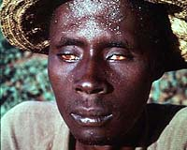
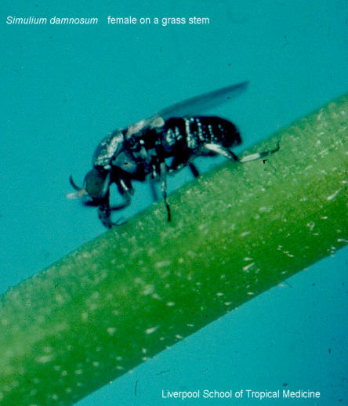
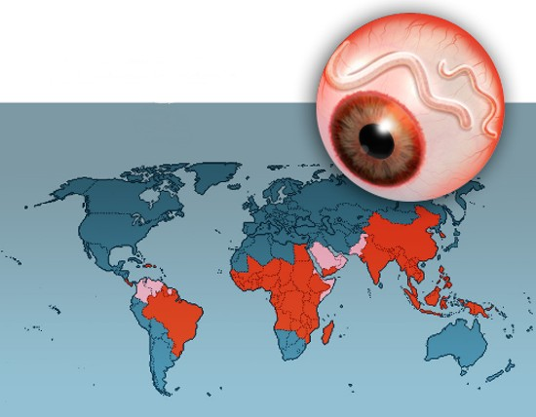
Pathogenic: Infectious Diseases
Onchocerciasis (river blindness)
  Vector: Black fly
  Many roundworms get into eyes & die causing blindness
  Control with insecticide sprays
  Merck & Co. are providing free ivermectin to help eradicate.

Slide 25
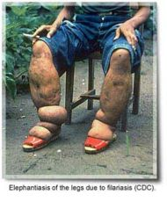
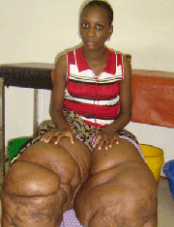
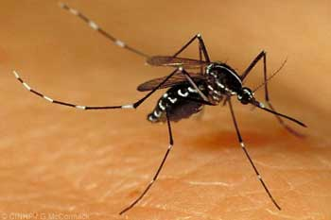
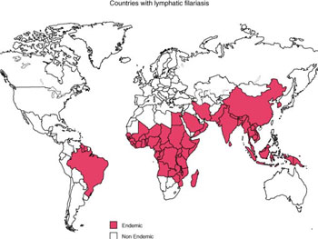
Infectious Diseases….
Elephantiasis
  Vector: Mosquitoes
  Roundworm gets into lymph system and blocks lymph vessels causing fluid build up in the extremities.
  SmithKline Beecham is supplying free albendazole to eradicate.

Slide 26
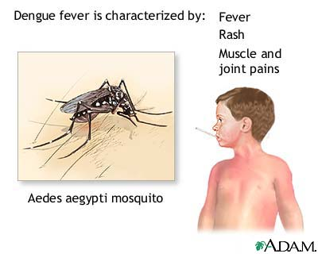
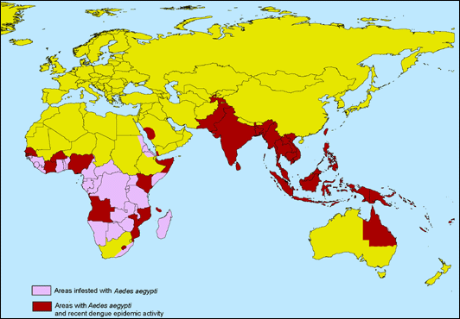
Infectious Diseases…
Dengue Fever
  Vector: Mosquitoes
  20 million new cases; 2.5 billion current cases

Slide 27
What causes disease to spread so rapidly?
Population density ↑, so contact ↑
Moving into remote areas for agriculture ↑ exposure.
Deforestation, pollution causing local & global climate change (↑ in temp = ↑ in mosquito pop.)
Eliminating predators so ↑ in rodent, roach, mosquito pop.
↑ in speed & frequency of travel (airplanes, ships) to other countries
↑ in resistance (Malaria) = “Superbugs”
Taking medication improperly leads to “superbugs”
Antibiotics given to farm animals increases their resistance.

Slide 28
Mechanisms for minimizing toxic effects
Every material can be poisonous/toxic at some level.
Most chemicals have safe levels or thresholds below which their affects are undetectable.
EX: 100 cups of coffee have enough caffeine to kill if consumed all at once- but most people don’t consume that much.
Taken in small doses, chemicals can be broken down by the body and released.

Slide 29
Xenobiotic
A xenobiotic is a chemical which is found in an organism but which is not normally produced or expected to present in it;
It can also cover substances which are present in much higher concentrations than are usual;
Specifically, drugs such as antibiotics are xenobiotics in humans because the human body does not produce them itself, nor are they part of a normal diet.

Slide 30
Factors affecting Xenobiotic
Physiochemical properties of toxicants;
Dose or concentration;
Mode and duration of exposure;
Environmental factors;
Interaction, and
Biological and nutritional factors.

Slide 31
Conclusion
Public health problems caused by environmental contamination and emerging infectious diseases are a growing concern worldwide.
Population growth and the associated pressures of development are increasing the difficulties associated with sustaining effective public health practices and policies.
Well-targeted interventions can prevent much of the environmental risk;
Worldwide, as many as 13 million deaths could be prevented every year by making our environments healthier;

Slide 32
Conclusion…..
Understanding environmental and ecological health is a prerequisite to protecting public health;
Advanced scientific knowledge and information will improve our understanding about the environmental contributions to disease and human health in a sustainable way.

